Slide 1
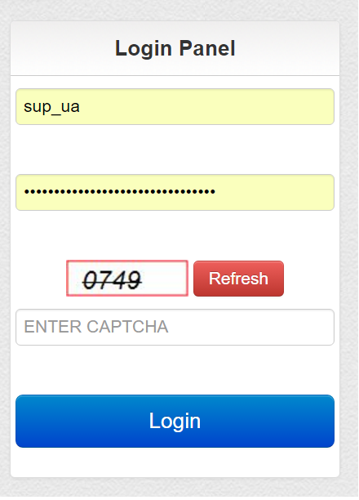
SUPPLIER LOGIN PAGE
ENTER THE USER NAME
ENTER THE PASSWORD
ENTER CAPTCHA
CLICK ON LOGIN
Notes:
Supplier Login Form, Provide the User ID Password with Valid Captcha then Click on Login.

Slide 2
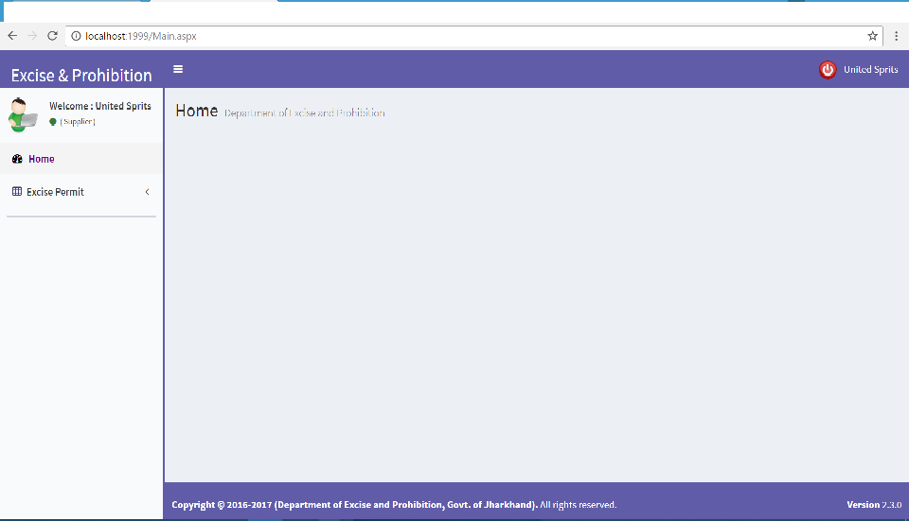
SUPPLIER DASHBAORD
LOGOUT
This is the menu for Applying for the Permit and Checking the Status of the permit as well.
Notes:
Supplier Dashboard with their Menus respectively.

Slide 3
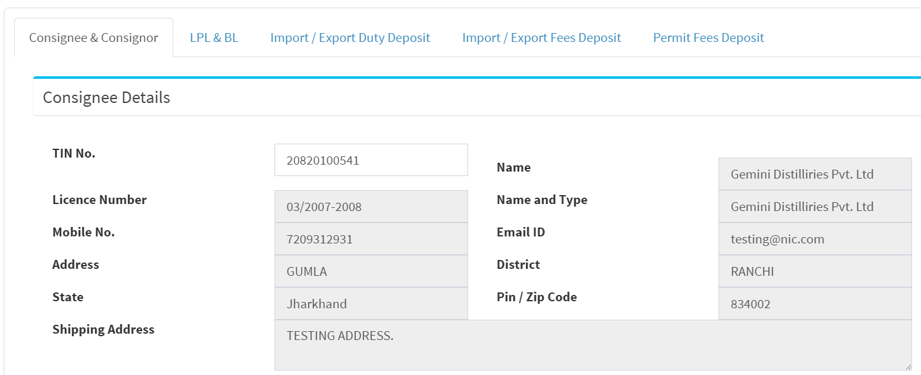
Apply for the Permit (Phase 1)
Enter the Consignee TIN No, Other data will be populated automatically
Notes:
Provide Consignee TIN No, then Other details will populate automatically.

Slide 4
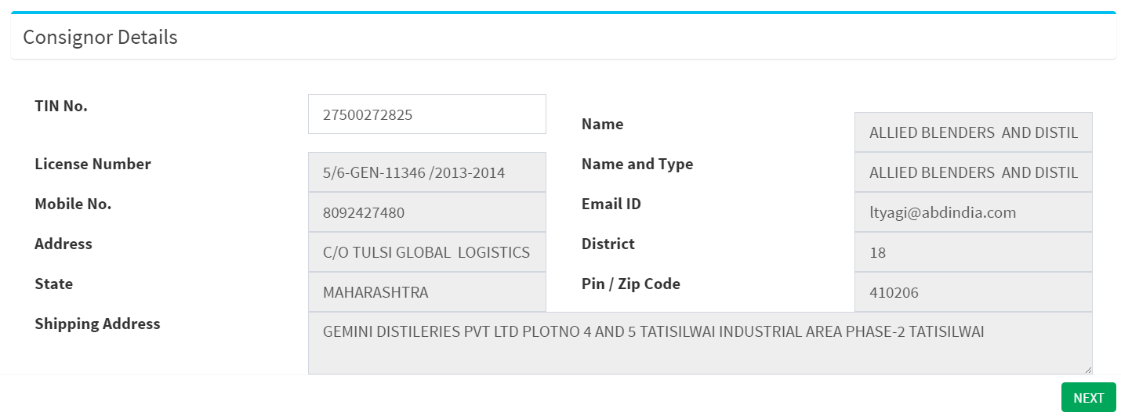
Apply for the Permit (Phase 2
Enter the Consignor TIN No, Other data will be populated automatically
Notes:
Provide Consignor TIN No, then Other details will populate automatically.

Slide 5
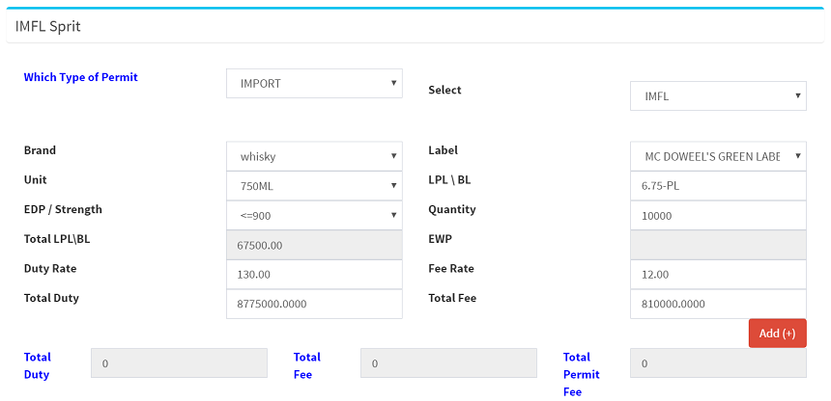
Apply for the Permit (Phase 3)
IMPORT Liquors (Brand, Label, EDP etc.)
Click on Add (+) for Submission
Notes:
Select the Brand, Label, Unit etc. for IMPORT then Click on Add(+) for the Submission your requirment.

Slide 6
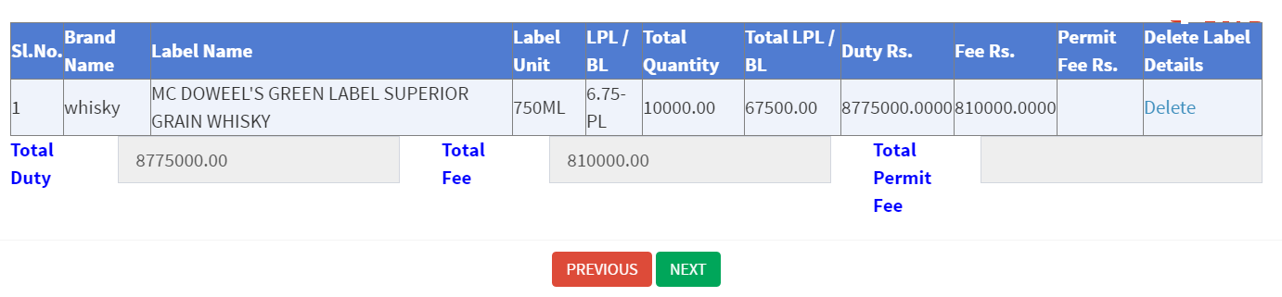
Apply for the Permit (Phase 4)
IMPORT Liquors (Brand, Label, EDP etc.)
Selected Brands and Label will added and it will show below like this. YOU CAN DELETE IF YOU SUBMIT ANYTHING WRONG
Delete Option
Notes:
Selected Brands and Label will added and it will show below like this. YOU CAN DELETE IF YOU SUBMIT ANYTHING WRONG

Slide 7
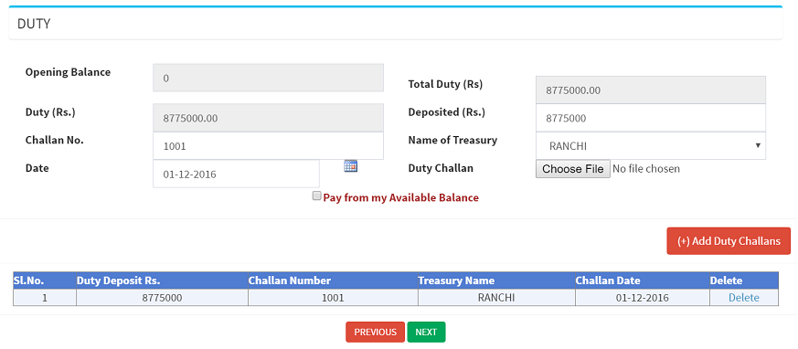
Apply for the Permit (Phase 5)
SUBMISSION PANEL FOR DUTY
Click on the button after submission all the documents
Notes:
DUTY Submission with Challan

Slide 8
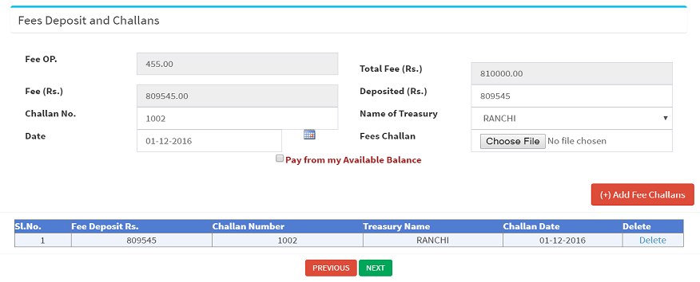
Apply for the Permit (Phase 6)
SUBMISSION PANEL FOR FEE
Click on the button after submission all the documents
Notes:
FEE Submission with Challan

Slide 9
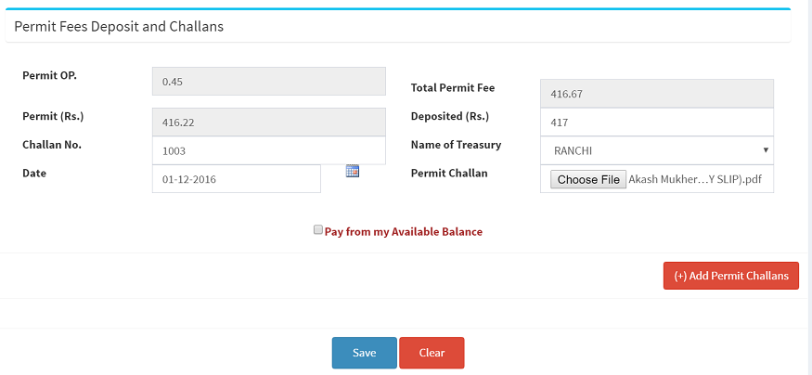
Apply for the Permit (Phase 7)
SUBMISSION PANEL FOR PERMIT
Click on Save Button, For Applying the Permit Finally.
Click on the button after submission all the documents
Notes:
Permit FEE Submission with Challan. After Completing all the Phase you can Apply for the Permit by Clicking on Save Button.

Slide 10
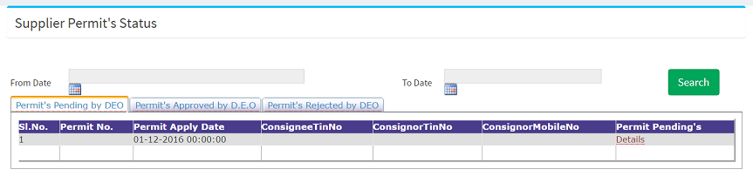
View your Permit Status by Click on the “ PERMIT STATUS ” Option.
Download / Print the Permits
Click for Check your Submission Details
Notes:
Pending , Approved, Rejected Permit Status with Download and Print Options for Permit.

Slide 11
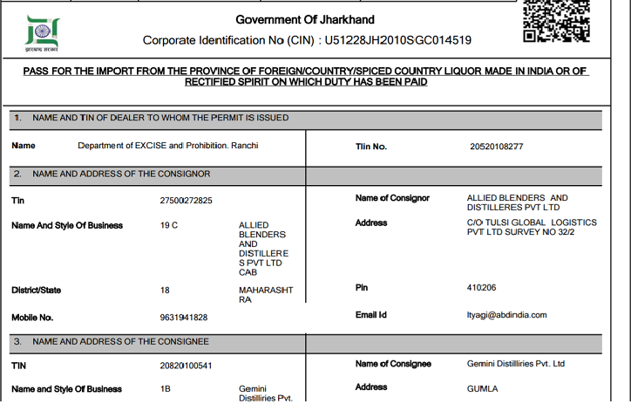
SUPPLIER PERMIT COPY.
Notes:
Supplier Permit Copy.

Slide 12

THANKING YOU !
Notes:
Thank you.

